Slide 1

NAME : MACDONALD A.C. IFEANYI
CAPSTONE PROJECT WITH 10ALYTICS
DATE : 11TH OF JULY 2024

Slide 2
OUTLINE
BACKGROUND
OBJECTIVE.
EXPLORATORY DATA ANALYSIS.
DATA PRE-PROCESSING.
BUILDING SUPERVISED MACHINE LEARNING MODELS.
BEST MODEL SELECTION AND PERFORMANCE METRICS.
FINDINGS AND RECOMMENDATION.
CONCLUSION.

Slide 3
BACKGROUND
Connect Tel is a leading telecommunications company at the forefront of innovation and connectivity solutions. With a strong presence in the global market, Connect Tel has established itself as a trusted provider of reliable voice, data, and Internet services. Offering a comprehensive range of telecommunications solutions, including mobile networks, broadband connections ,and enterprise solutions, Connect Tel caters to both individual and corporate customers, they are committed to providing exceptional customer service and cutting-edge technology.
Connect Tel ensures seamless communication experiences for millions of users worldwide. Through strategic partnerships and a customer-centric approach, Connect Tel continue s to revolutionize the telecom industry, empowering individuals and businesses to stay connected and thrive in the digital age.

Slide 4
OBJECTIVE
TO ADEQUATELY FORECAST CUSTOMER CHURN BY LEVERAGING ADVANCED ANALYTICAL TECHNIQUES.
2. TO PROPOSE A PRAGMATIC APPROACH THAT REDUCES CUSTOMER ATTRITION , ENHANCE CUSTOMER LOYALTY AND MAINTAIN COMPETITVE EDGE DIRECTED AT CUSTOMER RETENTION.

Slide 5
DESCRIPTIVE STATISTICS
 | count | mean | std | min | 25% | 50% | 75% | max
Senior Citizen | 7043 | 0.162147 | 0.368612 | 0 | 0 | 0 | 0 | 1
tenure | 7043 | 32.37115 | 24.55948 | 0 | 9 | 29 | 55 | 72
Monthly Charges | 7043 | 64.76169 | 30.09005 | 18.25 | 35.5 | 70.35 | 89.85 | 118.75

Slide 6
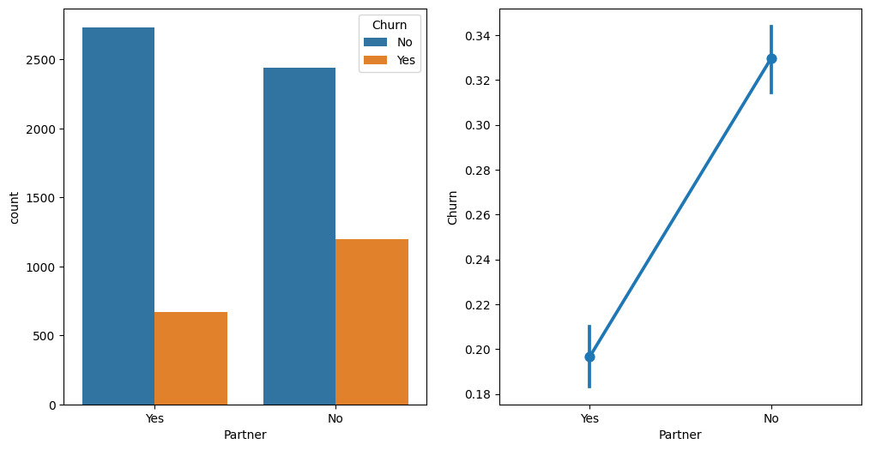
EXPLORATORY DATA ANALYSIS : UNIVARIATE

Slide 7
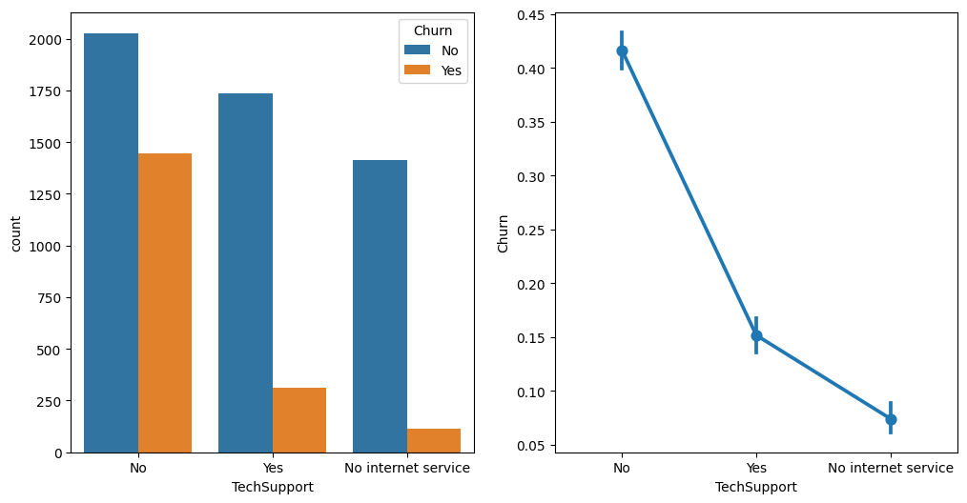
EXPLORATORY DATA ANALYSIS : UNIVARIATE

Slide 8
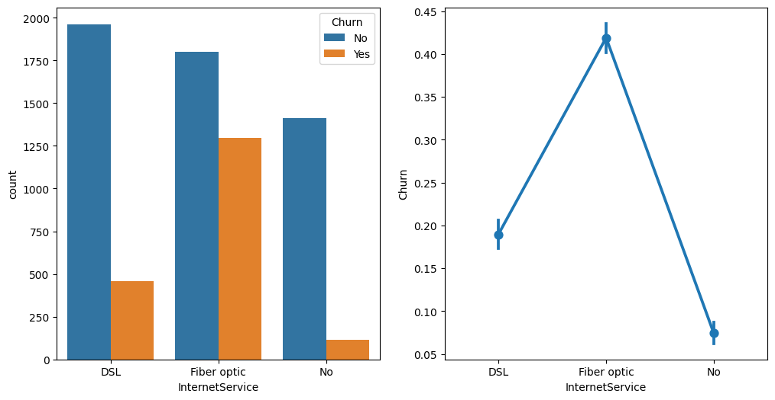
EXPLORATORY DATA ANALYSIS : UNIVARIATE

Slide 9
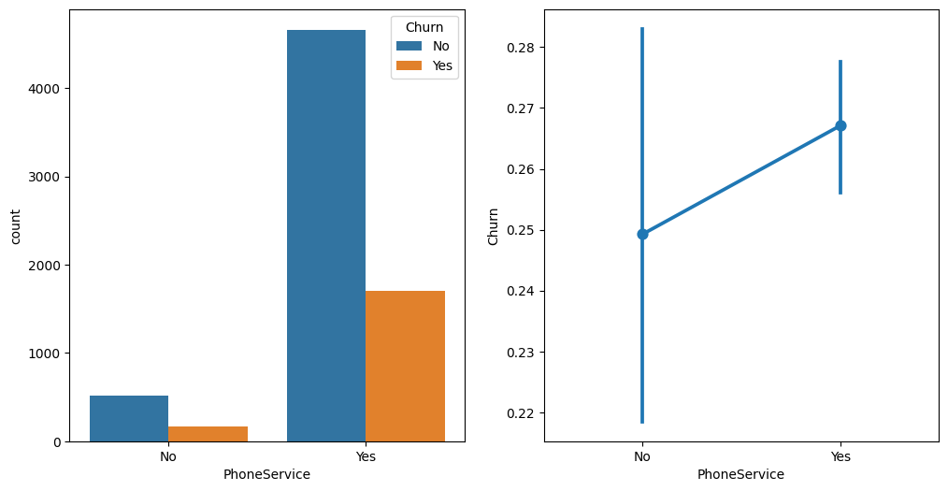
EXPLORATORY DATA ANALYSIS : UNIVARIATE

Slide 10

EXPLORATORY DATA ANALYSIS : UNIVARIATE

Slide 11
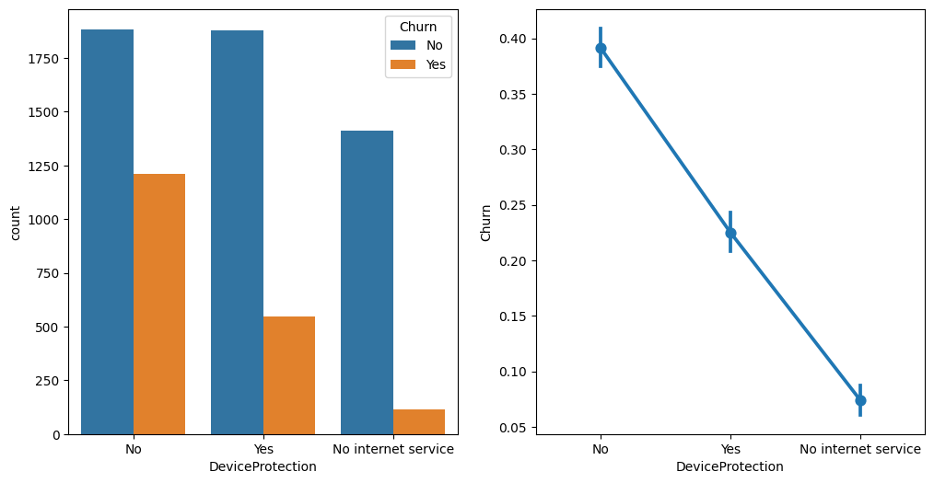
EXPLORATORY DATA ANALYSIS : UNIVARIATE

Slide 12
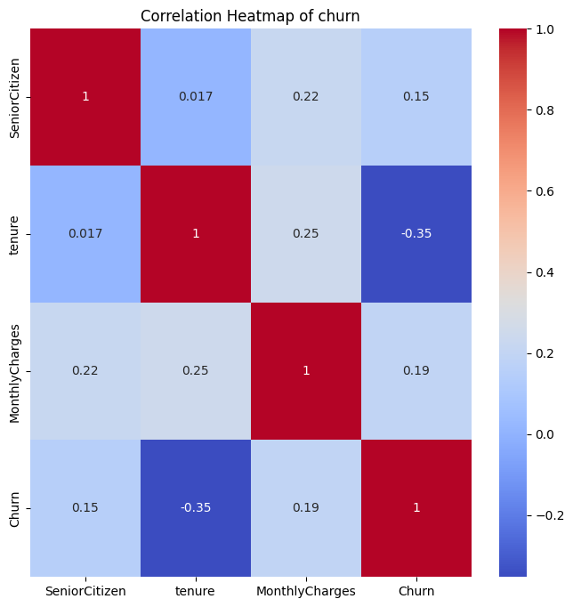
EXPLORATORY DATA ANALYSIS : BIVARIATE

Slide 13
EXPLORATORY DATA ANALYSIS : BIVARIATE
From the correlation Matrix above:
1. Churn has a weak-positive r/ship with Senior Citizen (0.15) , Monthly Charges (0.19) and a strong-negative r/ship with tenure (-0.35).
2. Tenure has a weak positive r/ship with Senior Citizen (0.02) , Monthly Charges (0.25) and strong-negative r/ship with churn (-0.35).
3. Monthly Charges has a weak-positive r/ship with senior citizen (0.22), tenure (0.25) and churn (0.19).
4. Senior Citizen has a weak-positive relationship with tenure (0.017), monthly Charges (0.22) and Churn (0.15).

Slide 14
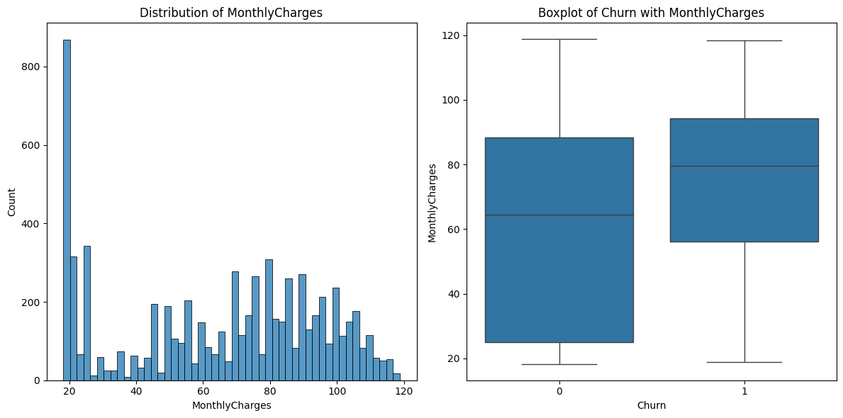
EXPLORATORY DATA ANALYSIS : BIVARIATE

Slide 15
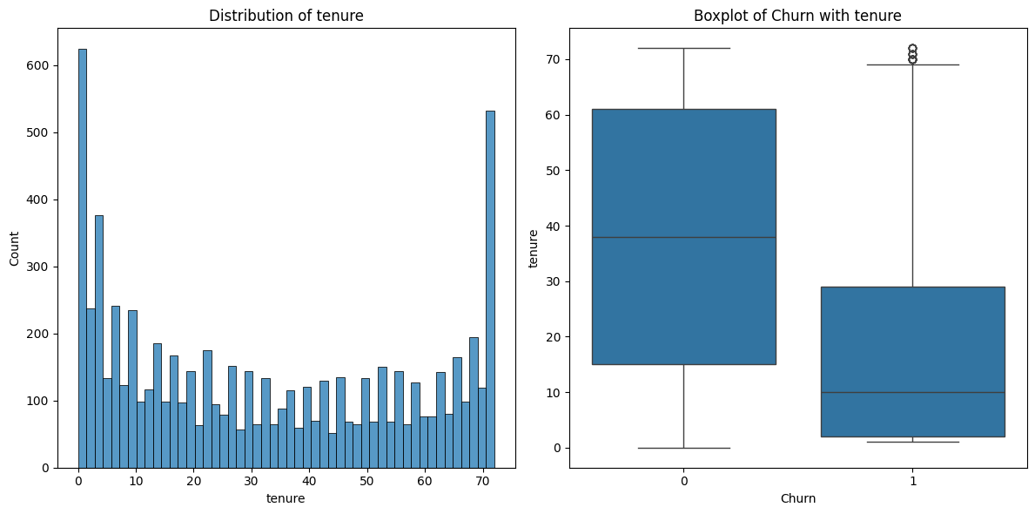
EXPLORATORY DATA ANALYSIS : BIVARIATE

Slide 16
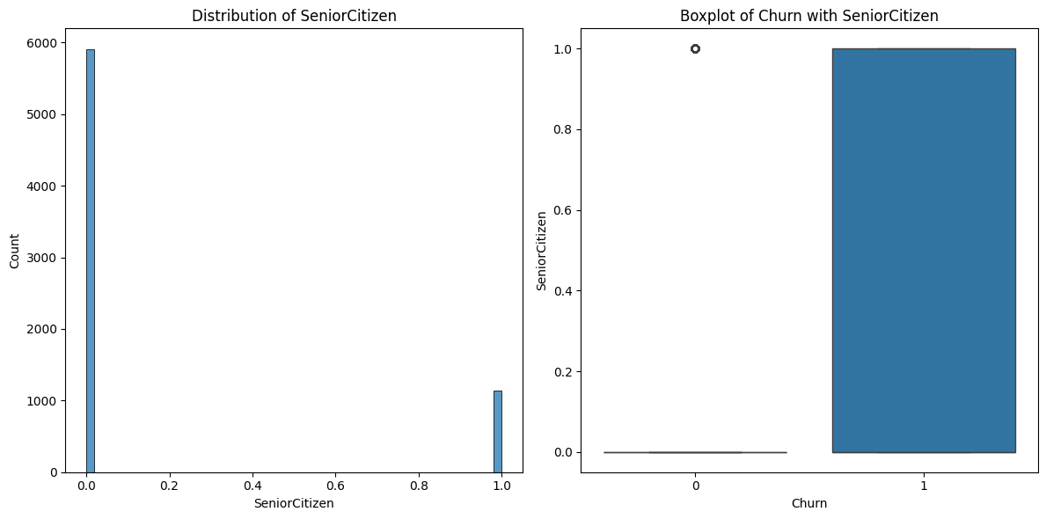
EXPLORATORY DATA ANALYSIS : BIVARIATE

Slide 17
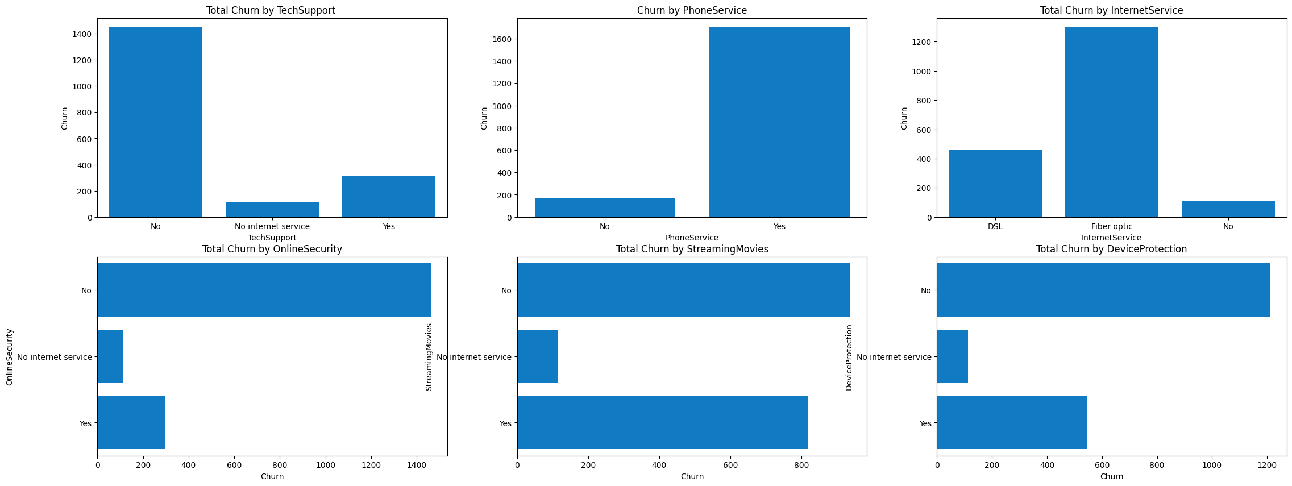
EXPLORATORY DATA ANALYSIS : MULTIVARIATE

Slide 18
DATA-PREPROCESSING:
Data-preprocessing was deployed using the Standard Scalar technique to address the issue of outliers . From the Boxplots under the Bivariate Exploratory Data Analysis slides, the presence of outliers was observed ,hence the need to manipulate the data within the range where Mean is -5.3098e-20 and Standard Deviation equals 1.
This ensures that the quality of data for Supervised Machine learning Modelling is optimized.
COLUMN | gender | SeniorCitizen | Partner | Dependents | tenure | PhoneService | MultipleLines | InternetService | OnlineSecurity | OnlineBackup | DeviceProtection | TechSupport
MEAN_VAL | 0.504756 | 0.162147 | 0.483033 | 0.299588 | 32.37115 | 0.903166 | 0.940508 | 0.872923 | 0.790004 | 0.906432 | 0.904444 | 0.797104
COLUMN | TechSupport | StreamingTV | StreamingMovies | Contract | PaperlessBilling | PaymentMethod | MonthlyCharges | TotalCharges | Churn
MEAN_VAL | 0.797104 | 0.985376 | 0.992475 | 0.690473 | 0.592219 | 1.574329 | 64.76169 | 3257.794 | 0.26537

Slide 19
SUPERVISED MACHINE LEARNING MODELS
Supervised Machine learning Models such as the ;
Logistic Regression(LR),
Random Forest Classifier(RFC) ,
Support Vector Classifier(SVC) ,
Ada Boost Classifier (ABC) .
All of which were deployed to build Machine Learning Algorithms for classifier task.
It is valuable to compare different models , accuracy score and baseline methods to determine the effectiveness in classification task and also the relative accuracy performance.
In specific, AdaBoost was deployed in order to train weak models on repeatedly adjusted weights of misclassified instances.it creates a robust final Model capable of accurate predictions by reducing overfitting.

Slide 20
FINDINGS AND RECOMMENDATIONS
An accuracy score of 78.53... from a Support Vector Classifier indicates that this particular SVC model correctly predicts the class of customer churn approximately 78.53% of the time on unseen dataset.
An accuracy of 78.71... from a Random Forest Model indicates that this Linear-Model correctly predicts the class of Customer Churn approximately 78.71% of the time on unseen dataset.
An accuracy of 80.01... from a Logistic Regression Model indicates that this Linear-Model correctly predicts the class of Customer Churn approximately 80.01% of the time on unseen dataset.
An accuracy of 80.01... from an Ada Boost Classifier Model indicates that this Support Vector Model correctly predicts the class of Customer Churn approximately 80.01% of the time on unseen dataset.

Slide 21
CONCLUSION
In conclusion, In terms of overall Model performance and accuracy both the Linear Model (i.e. Logistic Regression) and the Support Vector Machine Models (i.e. Ada Boost Classifier) performed better 80% of the majority of instances.
The negative relationship that exists btw churn and tenure is indicative of the fact that there’s need to formulate and implement policy strategies that will enhance customer loyalty and retention .This by implication will drastically reduce the rate of customer attrition.

Slide 22
THANK YOU @10ALYTICS
CAPSTONE PROJECT ON CUSTOMER CHURN
PRESENTED BY:
MACDONALD IFEANYI
PROACTIVEORACLE@GMAIL.COM

